Slide 1
Adult bed provision
CommunityBed and FloorBed
Reducing risk and promoting independence
Debra Dunitz and Curtis Farringdon

Slide 2
• To improve knowledge of the functions and features of the Accora bed range - to include FloorBed, CommunityBed and JuniorBeds
• To discuss the clinical benefits of the FloorBed and CommunityBed
• To find out how the autoregression technology reduces shear forces
• To link case study evidence to demonstrate the effectiveness of these products
• Live demonstration of the FloorBed, CommunityBed and Junior FloorBed
Learning Outcomes
Notes:
DD

Slide 3
The CommunityBed
Mattress platform height 220mm – 800mm
Knee break and auto regression back rest function
Anti-Trendelenburg and Trendelenburg function available as an option
Mattress platform of 90cm by 200cm
Compatible with standard foam and air mattresses
No trailing wires
Built in 20cm length extension
Safe working load: 215 kg (34 st)
Maximum patient weight: 180kg (28 st)
Notes:
ND / CF

Slide 4
Accessories
Bed lever
Side rails
Safety sleeve
Headboard and footboard padding
Lifting pole
Notes:
ND/CF

Slide 5
Why CommunityBed
User requires care to be carried out on the bed
User has difficulty with bed transfers
User has difficulty with bed mobility
User requires profiling mechanisms for bed positioning
User is at risk of bed falls – but has been risk assessed as safe with side rails

Slide 6
Why FloorBed
The risk of bed falls and associated injuries was apparent
Current interventions were reportedly not always adequate:
Side rails – Risk of entrapment, injury, distress.
Low bed with crash mat – Doesn’t always reduce the impact adequately.
Mattress on the floor – Transfers are likely to be challenging
Frequent supervision – Increase in carer burden and costs
A low bed wasn’t always adequate in enabling independent transfers and bed mobility.

Slide 7
The FloorBed
A fully functioning profiling bed with an ultra low function
Three Key FloorBed Benefits:
Reduce a fall to a roll; minimising injury
Promote independent bed transfers
Has been used to reduce care and equipment costs
Notes:
ND / CF

Slide 8
The FloorBed
FloorBed 1 - Mattress platform height 7cm – 65cm
Floorbed 2 - Mattress platform height 7cm – 80cm
Knee break and back rest function
Anti-Trendelenburg and Trendelenburg function
Mattress platform of 90cm by 200cm
Compatible with standard foam and air mattresses
Compact motor; reducing risk of damage by a mobile hoist
No trailing wires
Compact castors
Built in 20cm length extension
29 stone weight capacity
Notes:
ND / CF

Slide 9
Accessories
Bed lever
Side rails
Safety sleeve
Headboard and footboard padding
Lifting pole
Safety Mat with or without sliding sheets built in
Notes:
ND/CF

Slide 10
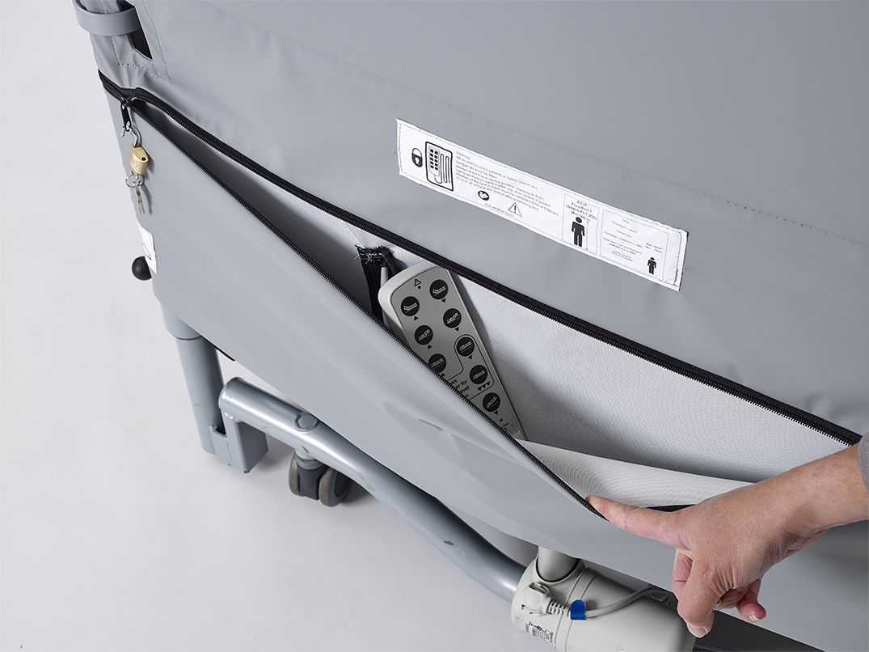
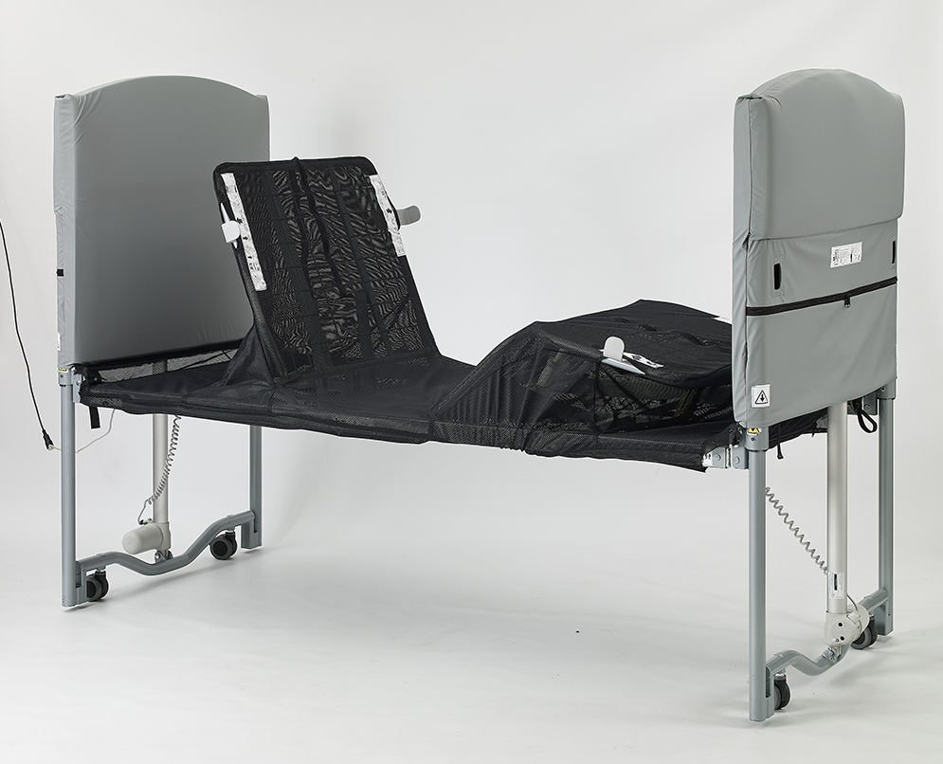
Junior Kit
Safety Sleeve
Encompasses complete mattress platform
Zips into head & foot end
Head & Foot Bumpers
- Padded cover for head & foot board
- Lockable compartment for handset
Notes:
CF

Slide 11
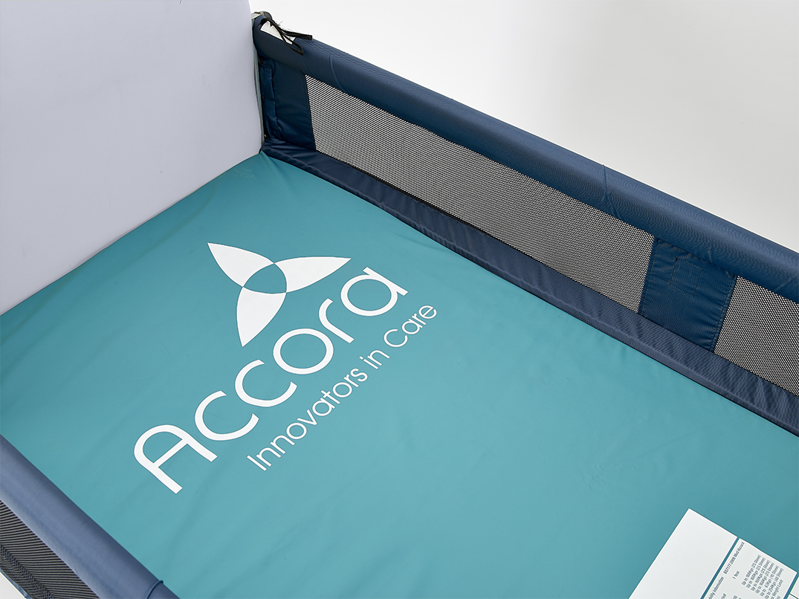
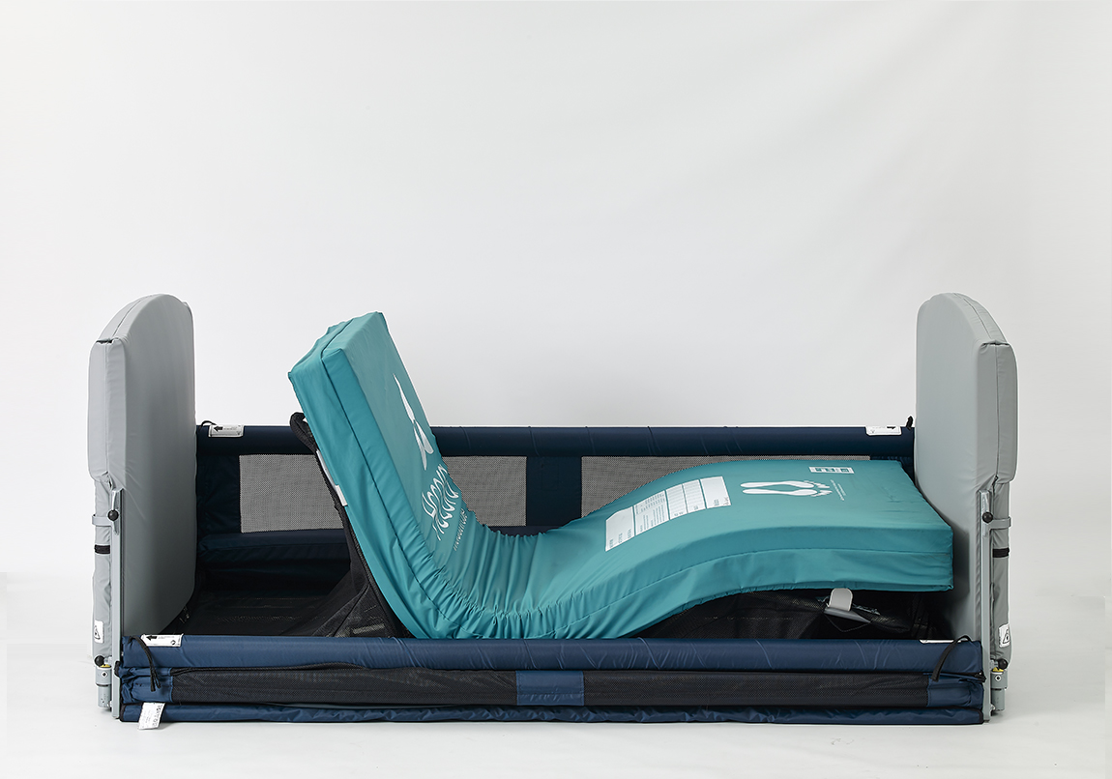
Accessories
Siderails
Padded, mesh fabric
Lockable in up and down position
In-built mattress infill
Firm Edge Mattress
Helps transfers
Less compression at siderails
Burrowing behaviors – Heavier to lift
Notes:
CF

Slide 12
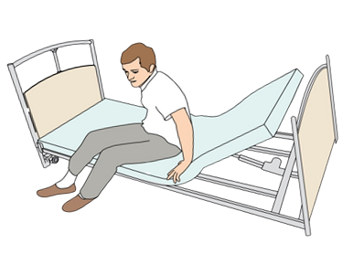
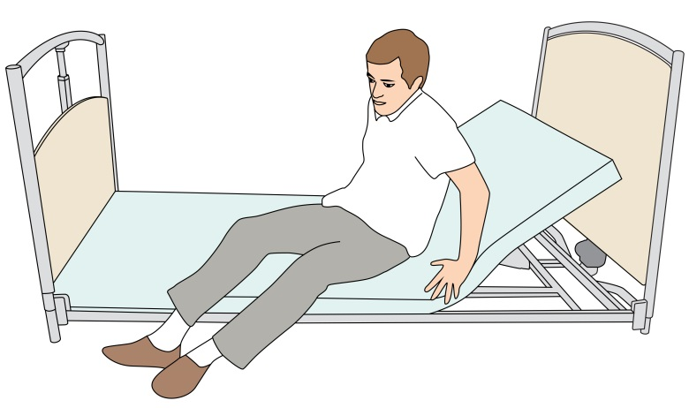
FloorBed prevented Freda from slipping off the edge of the bed
Enabled Freda to retain stability when sat on the edge
Enabled safe and independent bed transfers
Retained Freda’s independence and dignity.
Eliminated need for a care package or the need to sleep in her chair

Slide 13
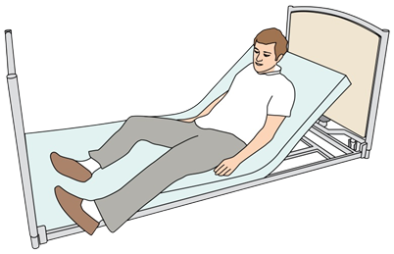
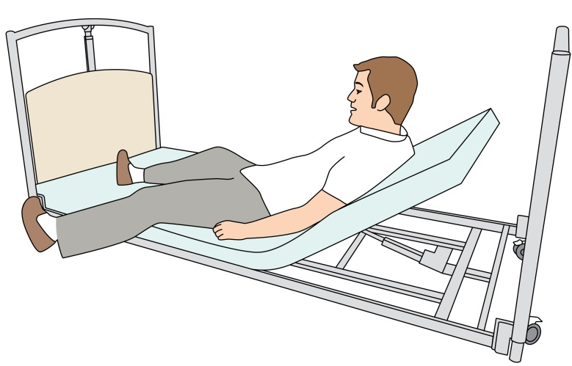
FloorBed enabled Colin to lift his legs into bed independently
Regained independence and dignity
Managed the Oedema in his lower limbs
Eliminated need for a care package

Slide 14
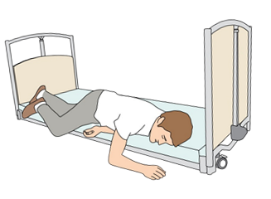
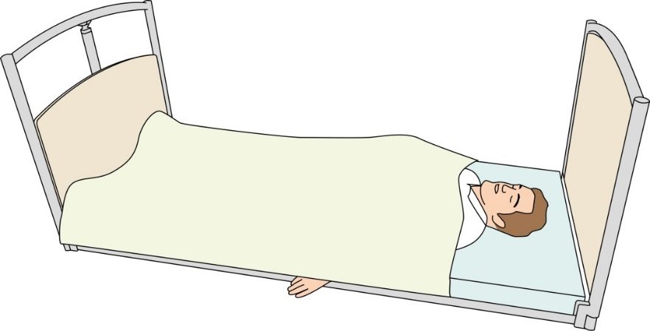
FloorBed reduced Tom’s anxieties, risk of bed falls and associated injuries
Tom could touch the floor and see it at eye level
Tom stopped hallucinating and was much calmer
Tom did not have any further bed falls
Reduced the burden and strain on carers

Slide 15
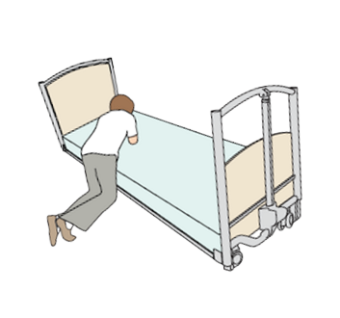
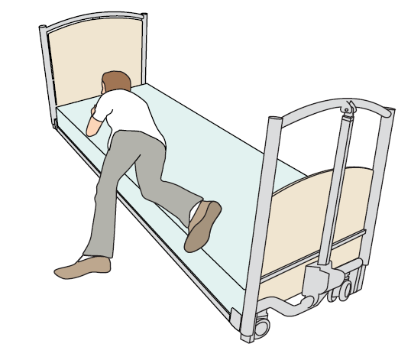
FloorBed enabled Charlotte to transfer into bed independently
Significantly reduced the level of strength and effort required
Promoted dignity and independence
Reduced dependence on family
Reduced the need for additional equipment

Slide 16
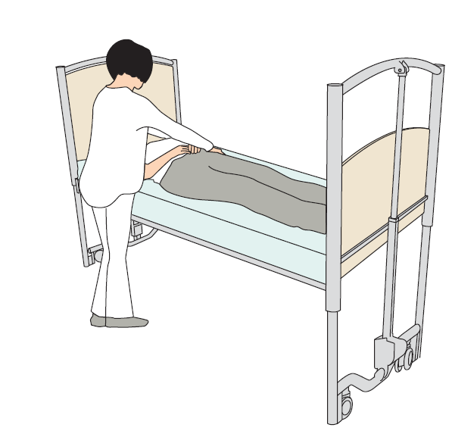
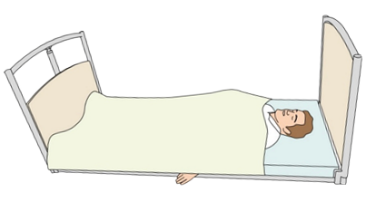
FloorBed reduced the risk of injury to Paul and his carers
Reduced risk of injury in the event of a seizure
Enabled care tasks to be carried out safely
Reduced the strain on the family when assisting with transfers

Slide 17
To improve knowledge of the functions and features of the Accora bed range - to include FloorBed, CommunityBed and JuniorBeds
• To discuss the clinical benefits of the FloorBed and CommunityBed
• To find out how the autoregression technology reduces shear forces
• To link case study evidence to demonstrate the effectiveness of these products
• Live demonstration of the FloorBed, CommunityBed and Junior FloorBed
To Summarise:
Notes:
DD

Slide 18
Questions
Notes:
DD/CF

Slide 19
Accora
Charter House, Barrington Road, Orwell, Cambridge SG8 5QP
T: +44 01223 206100
E: info@accora.care
W: www.accora.care

